Slide 1
EZLOANS
Loan Management App
Developed by: Anubhav Rajput, Arpan Ghosh, Davy Sharma, Sashrika Surya & Vardhah Anees
Under the guidance of: Rajashekhar GS

Slide 2
Outline
1
Introduction
Technologies Used
5
2
Aim & Objective of the Project
Project Modules
6
3
Functionalities
Relational Schema
7
4
System Requirements
Challenges faced & Scope of Improvement
8

Slide 3
Introduction
Developing an application which enables GIS Global Employees to purchase items from the GIS Global Mart and subsequently facilitates a flexible loan to purchase the same.

Slide 4
Aim and Objective
To develop a comprehensive Loan Management Application that caters to the loan application and approval process within a company.
To streamline the loan request and approval workflow.
To create an employee portal where an employee can login as a user or an admin that have their own separate functionalities.

Slide 5
Admin Functionalities
User Functionalities
Login and validate credentials
Login and validate credentials
Register and Manage customer data
Apply loan for a particular item
Add, Edit and Delete loan cards
View loan cards availed
Add, Edit and Delete items
View items purchased on loan cards

Slide 6
System Requirements
Software
Hardware
1
JDK 1.8
1
Memory - 8 GB/above
2
Eclipse IDE
2
Storage - 500 GB/above
3
Heidi SQL
4
Visual Studio Code
5
Postman

Slide 7






Technology Used
Version Control: Git
Presentation:
React
Backend Processing: Spring & Spring Boot
Database:
MariaDB
Build Tools:
Maven
Database
Connectivity:
Spring data JPA

Slide 8
Project Modules
Login Page
User can either login as admin or user. For successful login, user has to enter the correct email ID and password, this will redirect them to the Dashboard based on the roles saved for the user in the database.
For unsuccessful login an error message will be displayed.
Admin Dashboard
Customer Data Management:
Admin can create a new employee with name, email ID, gender, designation, department, date of birth and joining.
They can also view, edit and delete an existing customer.

Slide 9
Project Modules
Loan Card Management:
An admin can create a new loan card by just entering the loan duration.
They can also view, edit and delete an existing loan card.
Items Master Management:
An admin can create a new item by entering details such as the name, description, make, category and valuation.
Once added, they can edit, delete and view the item.
User Dashboard
On successful sign in, a user can apply for loan cards added by the admin.
They can also view the items and loan cards that they have applied for.

Slide 10
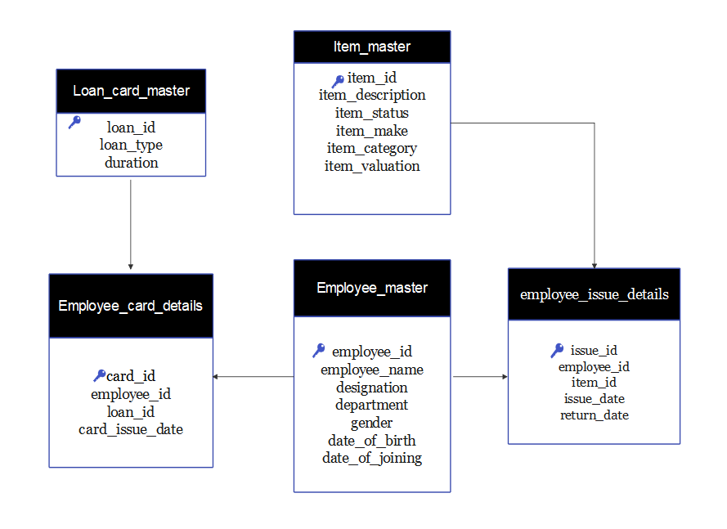
Database Architecture

Slide 11
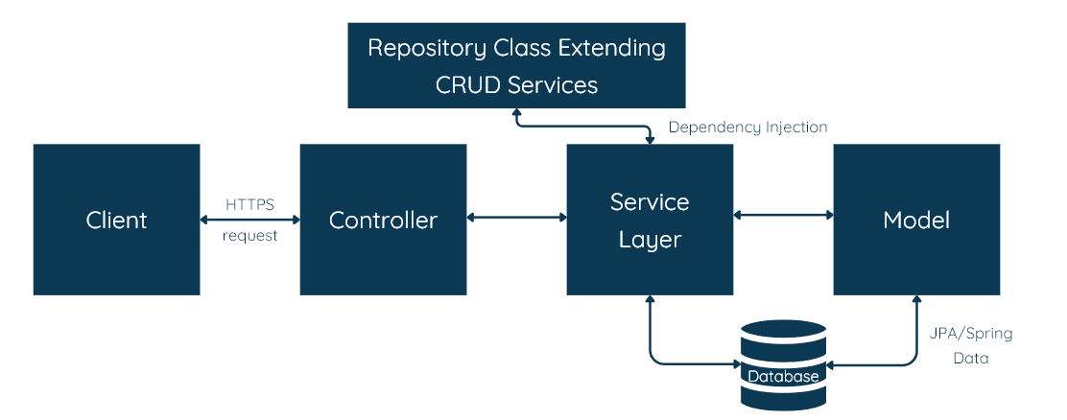
Backend Architecture

Slide 12
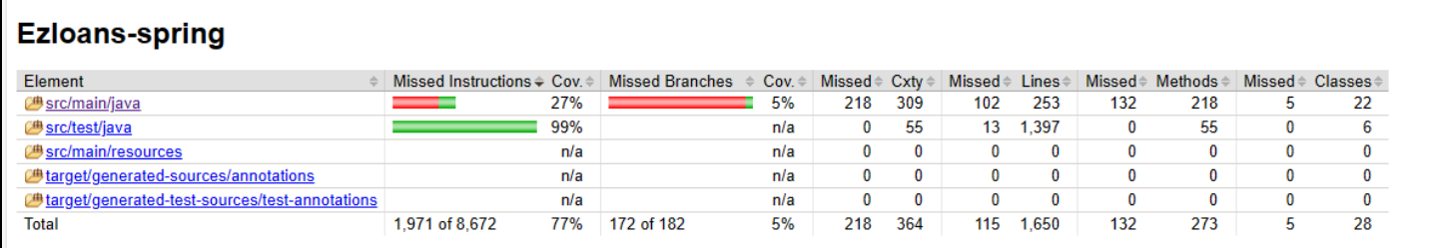
Unit Tests
Unit testing is a type of software testing that focuses on individual units or components of a software system.
We have used JUnit and Mockito for unit testing. JUnit is more general and related to unit tests in general, while Mockito focuses on mock objects and how to create them.

Slide 13
Challenges Faced
1
Database Management
3
State Management
2
Role Based Access
4
Unfamiliar Tech Stack
Managing same instance of database for different team members
Maintaining state information over multiple request for the same or different pages in the web application
Providing different functionalities to different users based on their roles.
Most of us were not familiar with tech stack.

Slide 14
Future Work
Integration with payment gateway
Admin could be given the provision to add custom images of products
User feedback and survey
Dashboard notification for admin for pending tasks
Wishlisting items that are currently out of stock

Slide 15
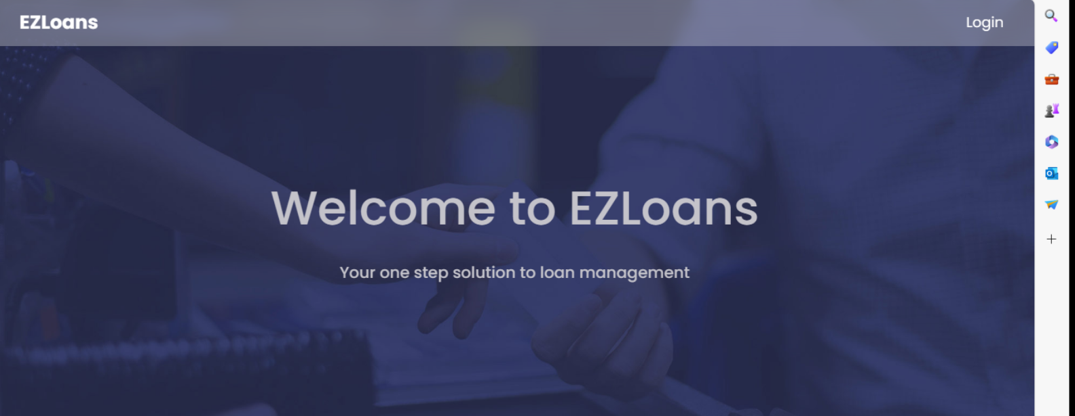
DEMO

Slide 16
Thank You

